Slide 1
Data-exploration of free fx data

Slide 2
データ: histdata.com
66 通貨ペア
時間インターバル: 1 min
The timezone of all data is: Eastern Standard Time (EST) time-zone WITHOUT Day Light Savings adjustments.
Fields: DateTime,Open,High,Low,Close,Volume

Slide 3
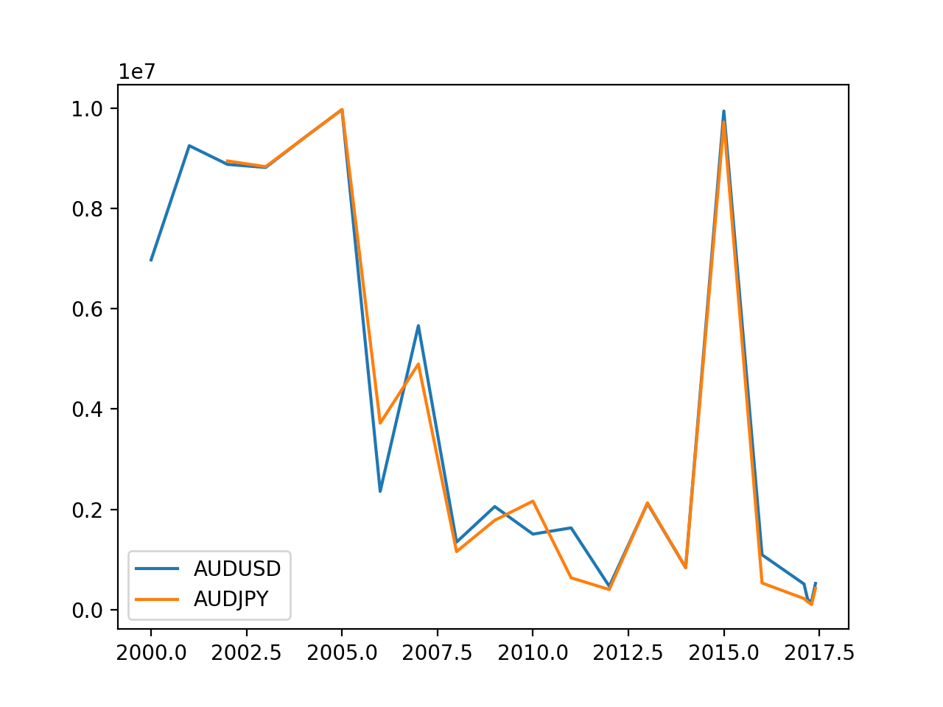
最大 インターバル: 8 – 170 min
Interval [ms]
year

Slide 4
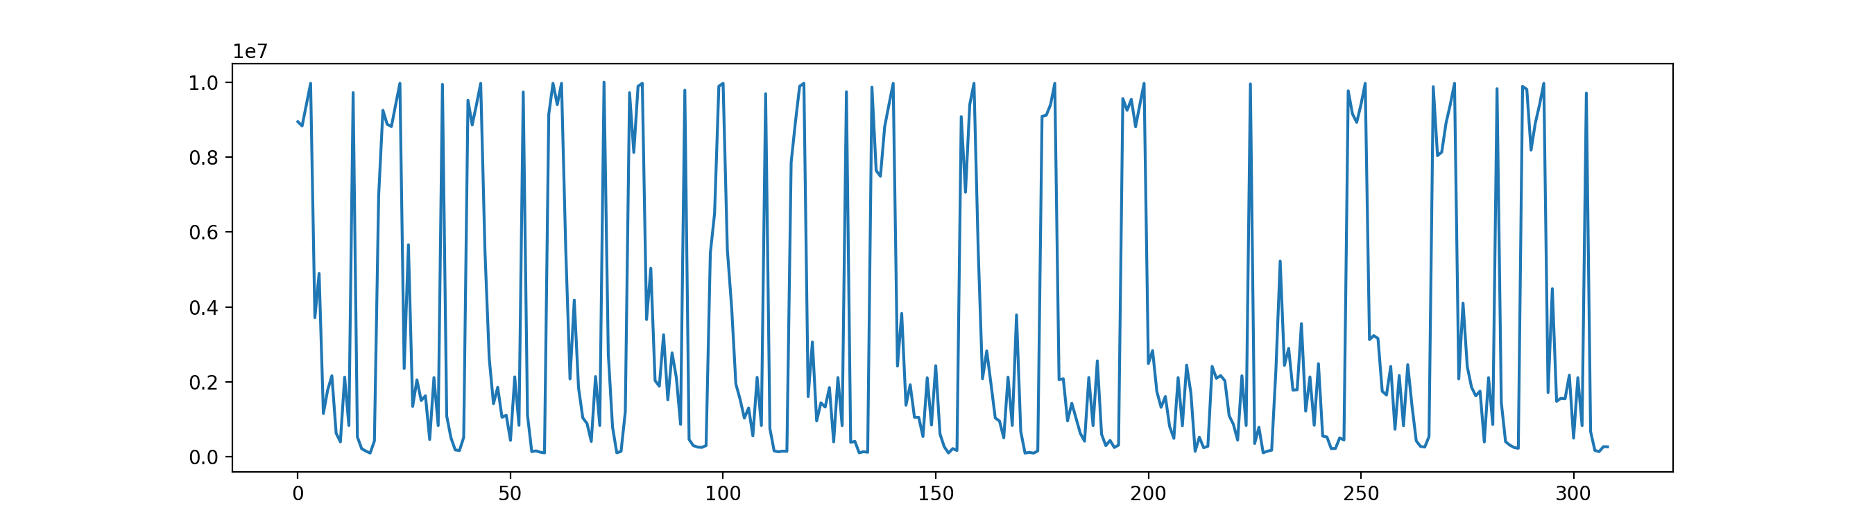
All max interval
Interval [ms]
Time + currency pair [A.U.]

Slide 5
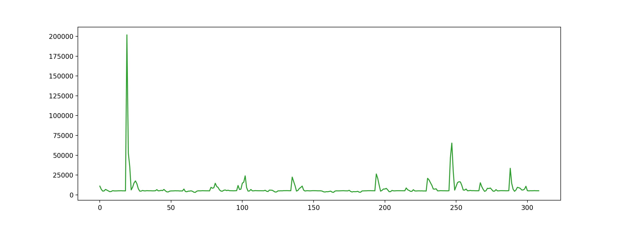
平均インターバル
3 - 200 sec
Interval [ms]
Time + currency pair [A.U.]

Slide 6
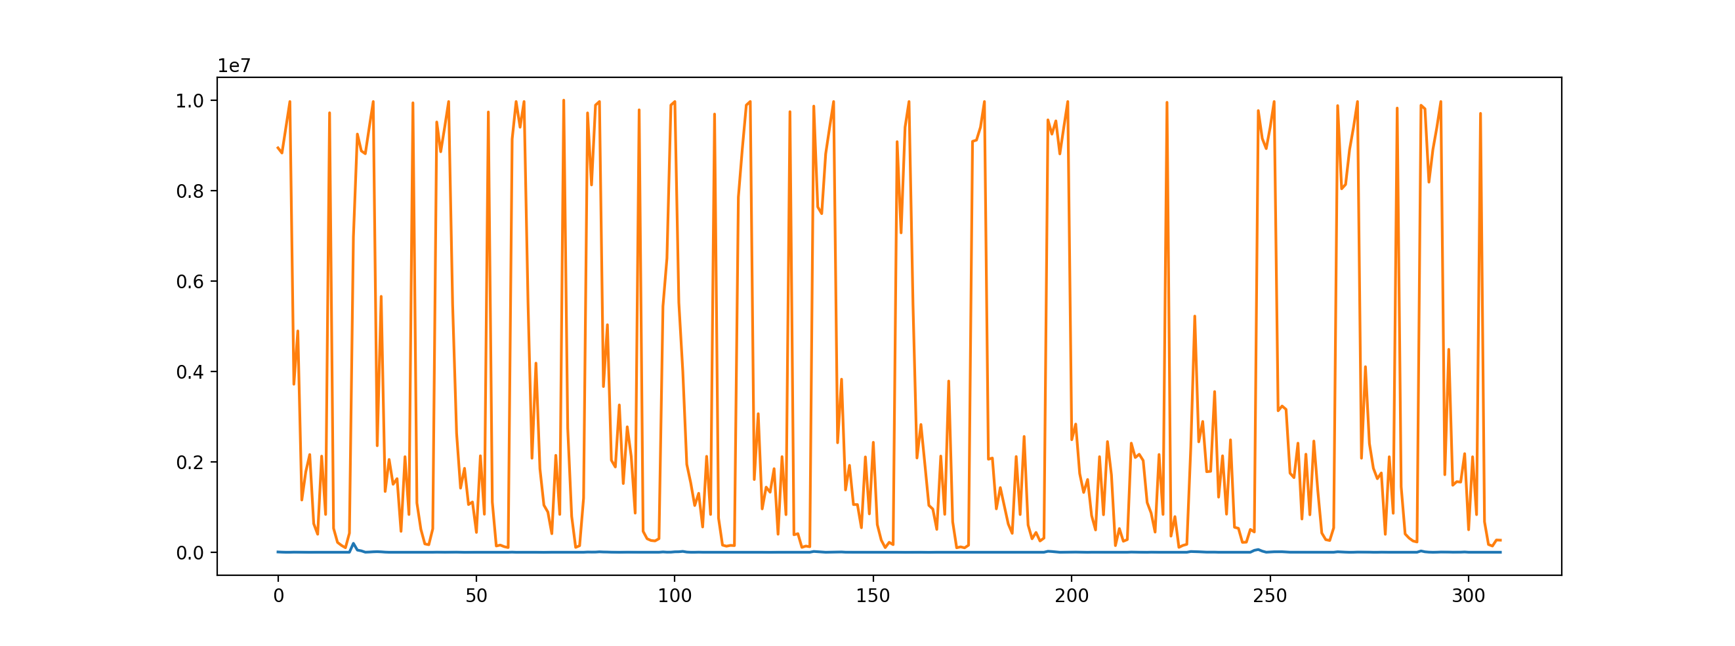
Max and average interval
Interval [ms]
Time + currency pair [A.U.]

Slide 7
Number of datapoints
1000 -1400 per day
Less during holidays (new year, easter, christmas)
Saturedays: 0
Sundays: 300-400

